Slide 1

FeedApp The PollHub
Technology stack
Front-End: React, JavaScript
Back-End: Spring Frameworks, Java, JPA, REST API
Database: MySQL
IOT-devices: Flutter
Analytics: MongoDB
Messaging systems: RabbitMQ

Slide 2


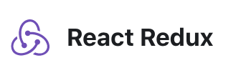
Front-End
React:
Reason for choosing; what do we wanna learn for front end, React and it became React.
React Router: Used to enable URL navigation between components
React Redux: Central store of states, used for easy access to states between components

Slide 3



Back-End
The backend is composed of the following components
Swagger REST API Doc
Spring Framework
with Data/Rest/Session/Security modules
Hibernate ORM / JPA Persistence to interact with the database.

Slide 4


Database/Messaging systems
MySQL:
Relational database used to manage and store the user, roles, polls, votes and the relation between these.
RabbitMQ Messaging
Is used to handle the subscription to events, and publishing of events from the system.

Slide 5

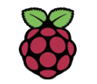
IOT-devices
Flutter
Implemented a simple device in a JavaScript webapp that can be deployed to a Raspberry PI or anything that can run a browser.

Slide 6

Analytics
MongoDB
The results are published to a NOSQL database.

Slide 7


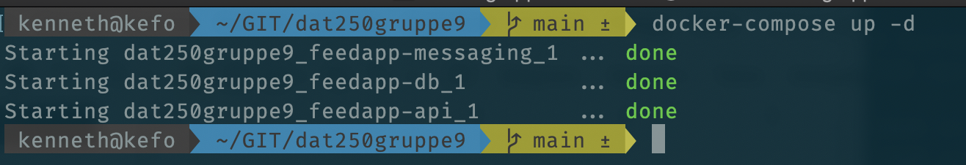

Cloud deployment
The app is Dockerised so it can be deployed in the cloud.
We have chosen the Google Cloud Platform, To utilize the combination of Kubernetes and Docker

Slide 8


TechStack Summary
FrontEnd
Backend
IoT
App
Hw
Db/Msg
Cloud

